Slide 1
SAP BTP Build Apps Training
Day 8
Anubhav Oberoy
www.AnubhavTrainings.com
Follow excellence with sheer passion

Slide 2


DISCLAIMER
The training content and delivery of this presentation is confidential, and cannot be recorded, or copied and distributed to any third party, without the written consent of Anubhav Trainings

Slide 3
Agenda – Day 8
01
Add to Cart
02
Intro to BPA
03
Create and Deploy process

Slide 4




















Slide 5













Slide 6
SAP BTP Build Process Automation
SAP Build Process Automation is a citizen developer solution to adapt, improve, and innovate business processes with no-code workflow management and robotic process automation capabilities.
SAP Build Process Automation enables business users and technologists to become citizen developers. With powerful yet intuitive low-code and no-code capabilities, the solution supports you in driving automation by tapping into the expertise of citizen developers.
Features
Build or adapt processes with an intuitive graphical interface.
Create forms-based workflows using drag-and-drop functionality.
Develop and manage decision logic in tabular, spreadsheet-like decision tables.
Automate repetitive tasks within existing process flows using robotic process automation.
Create intelligent actions and recommendations using machine learning capabilities.
Work efficiently from a unified launchpad and task center.
Hand over projects to professional developers, who can embed actions and advanced workflows into projects initiated by citizen developers.
Support real-time, event-driven transparency into comprehensive processes and process instances with process visibility dashboards.
In addition, SAP Build Process Automation offers prebuilt content and features – such as bots, process steps, business rules, and workflow components.

Slide 7
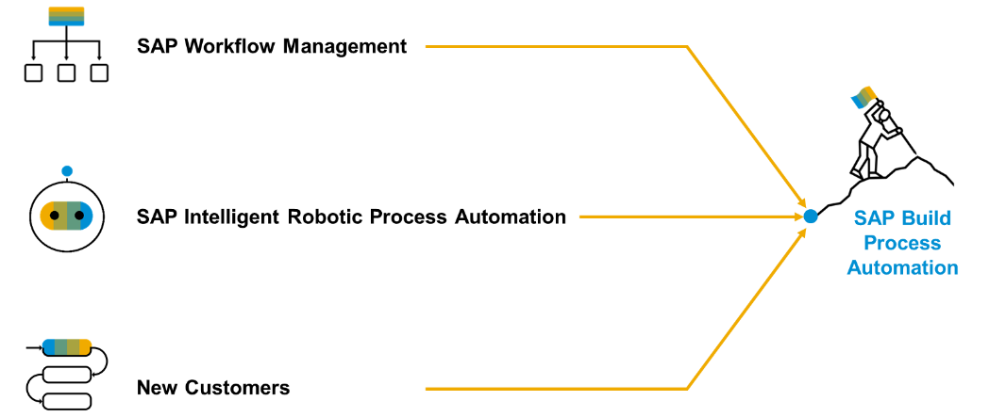
Product Overview
SAP Build Process Automation is a solution that evolved out of the former stand-alone SAP products - SAP Workflow Management and SAP Intelligent Robotic Process Automation. It provides a new citizen developer experience that didn't exist in either of the two former products.
As you or your company might have used SAP Workflow Management or SAP Intelligent Robotic Process Automation in the past, you are looking for a path into the joined solution. Fortunately, SAP Build Process Automation is fully compatible with all workflow and automation artifacts that you have created.

Slide 8
Deploy the BPA process
Design time object
process
Runtime object
process
deploy
We can check the control tower > environment,> process > triggers when open the same we can find the API and the context.

Slide 9


Scenario
Build Process Automation
BTP
Sales Order
(Build Apps)
approval
<data>
app
rej
Manager
<data>
Sales Representative
Build workzone
My Inbox
S/4HANA

Slide 10
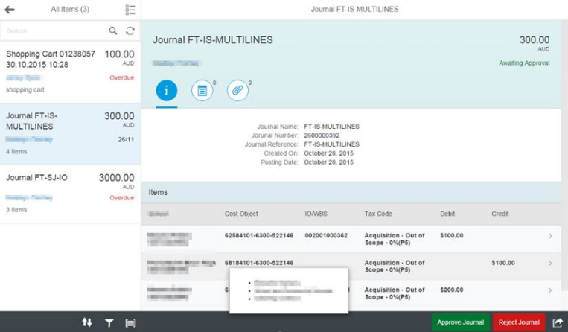
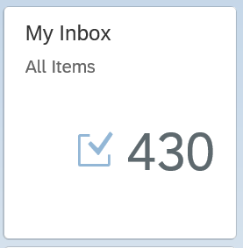
My Inbox Fiori App
In SAP Business Technology Platform (BTP), the Inbox Fiori app typically refers to an application that provides a centralized view for managing tasks and notifications within the system. This app allows users to handle workflow tasks and process approvals directly from within the Fiori interface.
Here are some key points about the Inbox Fiori app:
1. Task Management: It provides an interface where users can view, manage, and act upon their tasks. These tasks can be related to business workflows, approvals, or notifications that need attention.
2. Integration with SAP Workflow: The Inbox app is often integrated with SAP Business Workflow, allowing users to interact with tasks that are part of larger business processes.
3. User-Friendly Interface: As part of the Fiori design principles, the app offers a simple, intuitive, and responsive user interface that can be accessed on desktop and mobile devices.
4. Real-Time Updates: Users are notified of new tasks, and updates to tasks are reflected in real-time, ensuring that users can stay on top of their workload.
6. Access Control: Only users with appropriate roles and permissions can access specific tasks, ensuring that the right people are notified and able to act on the tasks.

Slide 11
The destination sap_process_automation_service
https://help.sap.com/docs/build-process-automation/sap-build-process-automation/configure-sap-build-process-automation-destinations

Slide 12

The Postman tool
Postman is a popular API (Application Programming Interface) testing and development tool. It provides an easy-to-use interface for interacting with APIs, enabling developers, testers, and other users to test, debug, and document APIs efficiently. It is widely used in the software development lifecycle to ensure that APIs function as intended.
Send requests (GET, POST, PUT, DELETE, etc.) to APIs and receive responses.
Validate the API’s behavior, response codes, and data.
Simplifies sending HTTP requests without needing to write complex scripts.
Supports various authentication methods like OAuth, Basic Auth, Bearer Token, etc.
Reduces manual effort by automating repetitive tasks.
Helps in documenting APIs for better team understanding.
Integrates well into agile and DevOps workflows.
It is available as a desktop application, web application, and browser extension, making it accessible across different platforms.
https://www.postman.com/downloads/

Slide 13
APIs on API HUB
https://api.sap.com/api/SAP_CP_Workflow_CF/resource/Workflow_Instances

Slide 14













SAP BTP CF Security Concept

Slide 15

What We Did
Let’s Summarize

Slide 16

www.anubhavtrainings.com
Thank You
End of Day 8

Slide 17


We’re committed to empower you to be
#FutureReady
through powerful training solutions.
We build the workforce of the future.
250+
Corporate Clients
30,000+
Learners Trained
25000+
Learners Placed
FREE WEBINARS
Sign up for free webinars with industry experts every fortnight!
Enroll Now!
Contact us today!
https://anubhavtrainings.com

